Slide 1
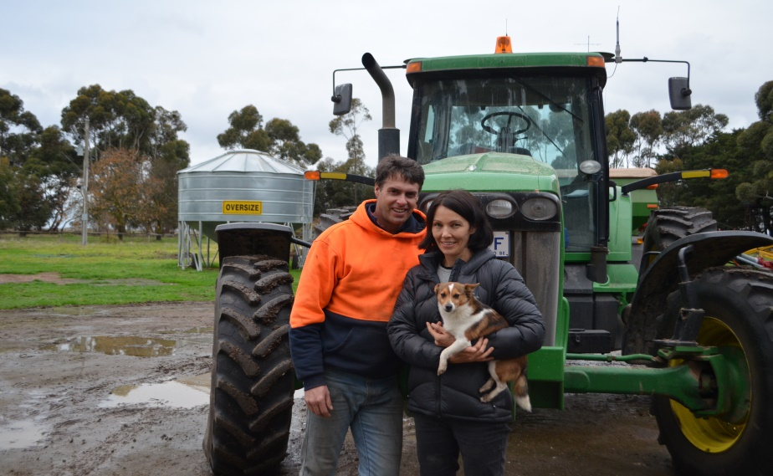
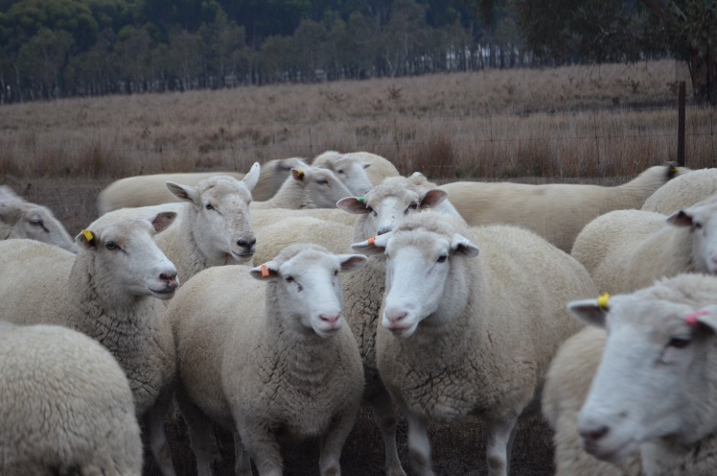
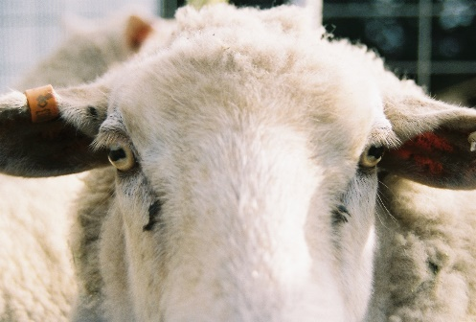
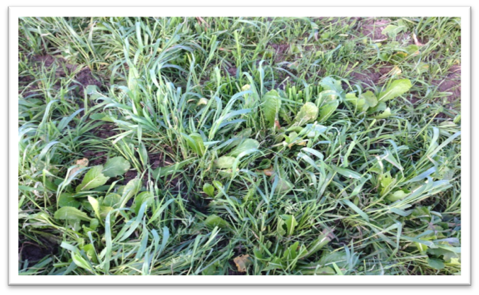
A snapshot:
Evan and Suzanne Lewis,
farming in Werneth, Victoria.
Predominantly grey loam soils and some heavy clay soils (five different blocks).
Zero-till CTF and run 1300 self replacing White Suffolk Composite ewes. Trade merino wether lambs

Slide 2
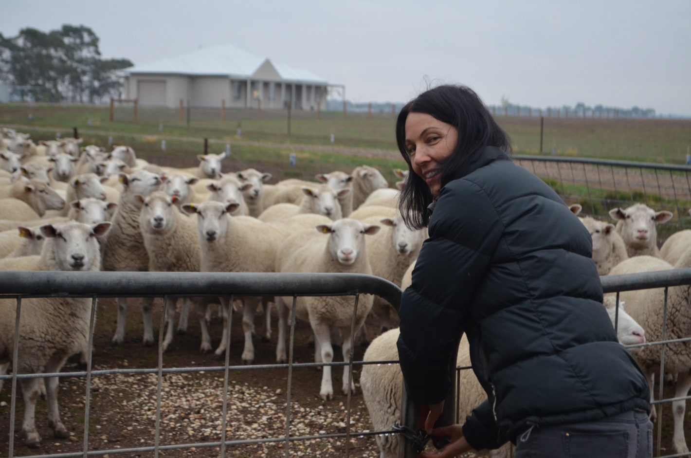
A little about myself…

Slide 3
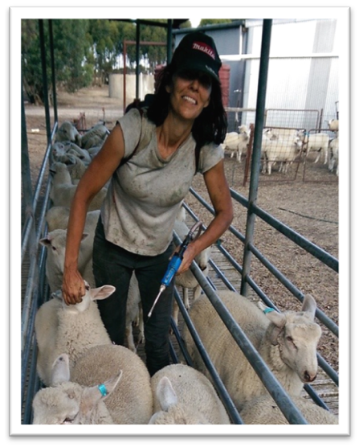
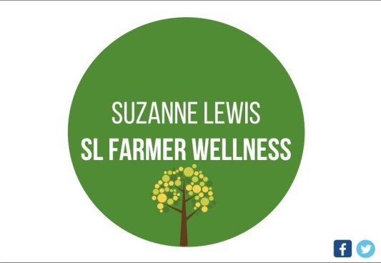
A few different hats…
Notes:
Like everyone, I wear a few different hats. But besides my mum and wife hat, my farmer hat is by far my favourite.
Sometimes I combine my farmer and health sciences hat to talk about famrer wellness.

Slide 4
Our farming journey to date….

Slide 5
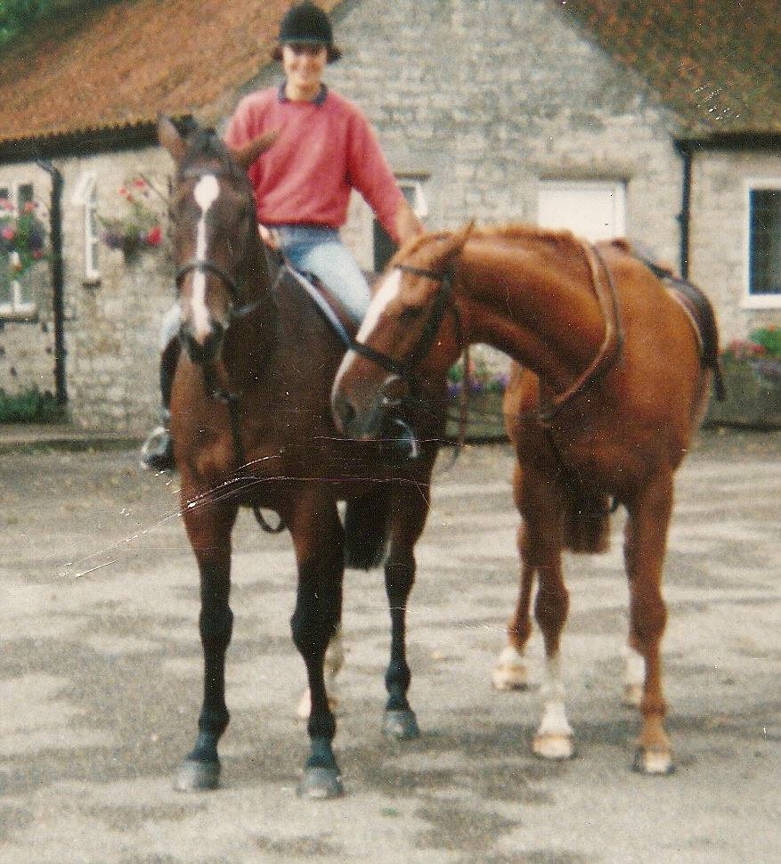
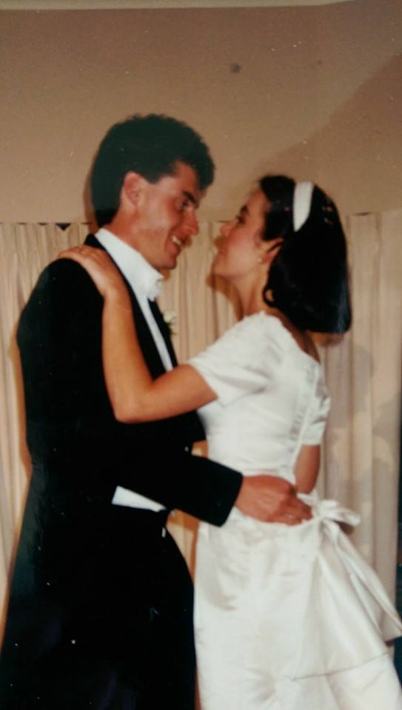
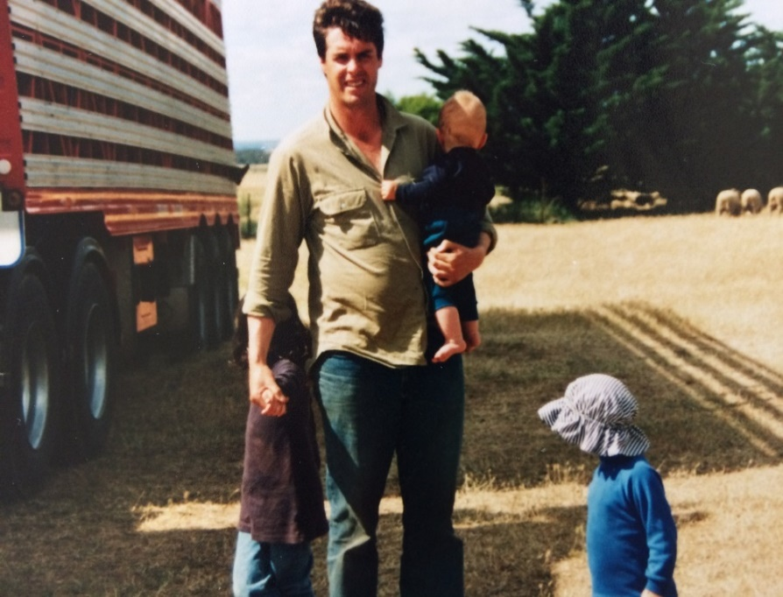
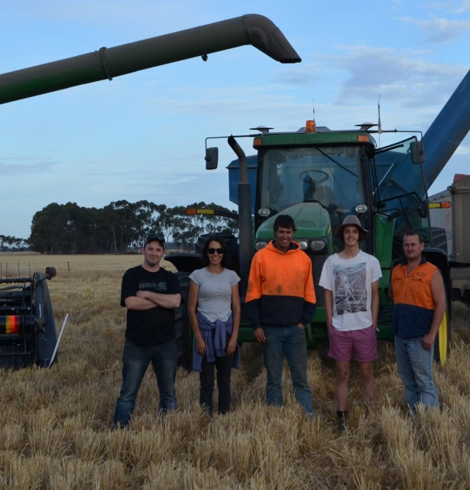
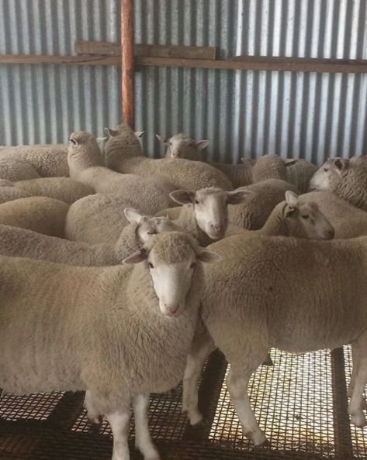
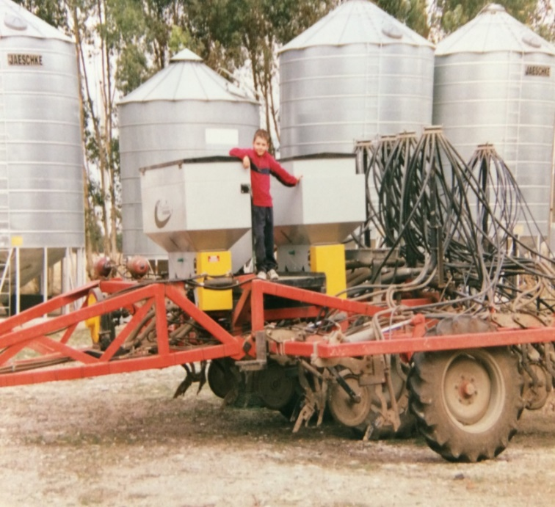

Slide 6
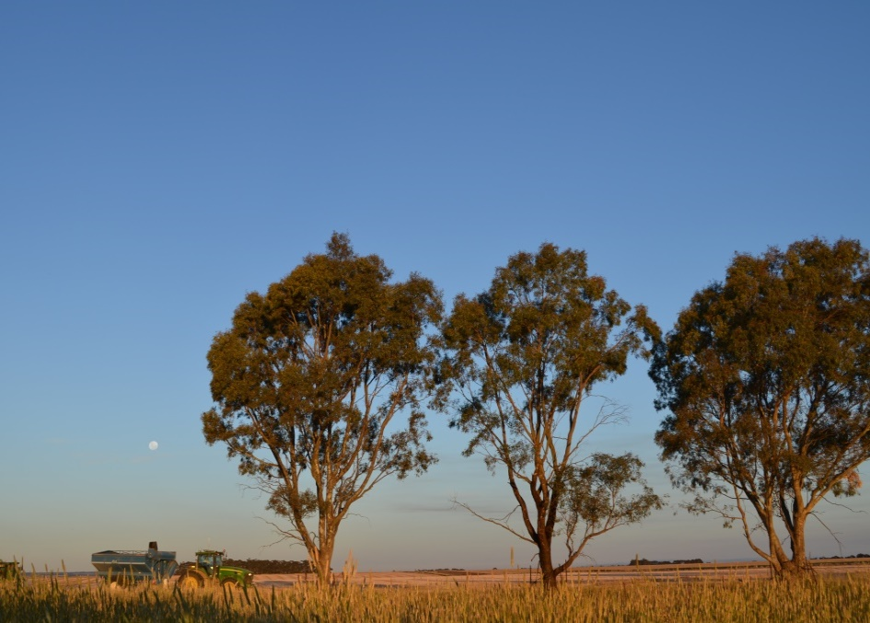
It hasn’t been all beer and skittles along the way…
Drought 2006
Fire 2007
Frost 2007
Flood 2010/2011
…but we’re still going strong!
Notes:
2006 was the peak of the no-till/no sheep theory – so much so we bought a farm down near Port Fairy to extradite the sheep and me and the kids). Disaster hit the day before we took the property over, with a fire burning everything except the house and sheds. All boundary fencing destroyed.
Many challenges…….

Slide 7
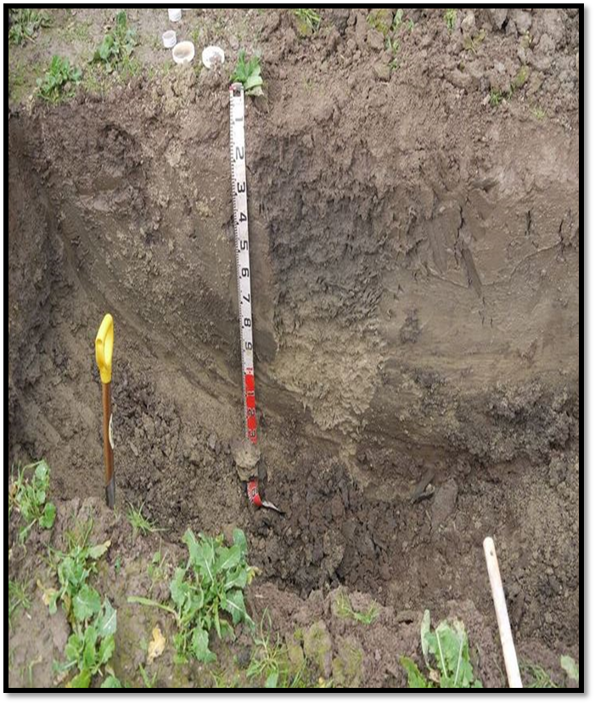
The turnabout: digging deeper…
2013 - Visit from Jill Clapperton, Montana USA
The benefits of including livestock into the system.
Evan’s US trip: Introduction of cover crops into the rotation.
Notes:
Jill’s theory was livestock are an essential component to stimulating the soil biology.
This is a soil pit which was dug in our back paddock for her visit in 2012. She told us the soil was sick, root depth was only about 20 cm. From my observations this was a cement paddock - poor animal health problems in the early days.
This paddock has really been a test plot – yard stick for what we’re trying to achieve. It has had three covers and we’ve seen some real improvements in , in particular soil porocity

Slide 8
Where we are presently…

Slide 9
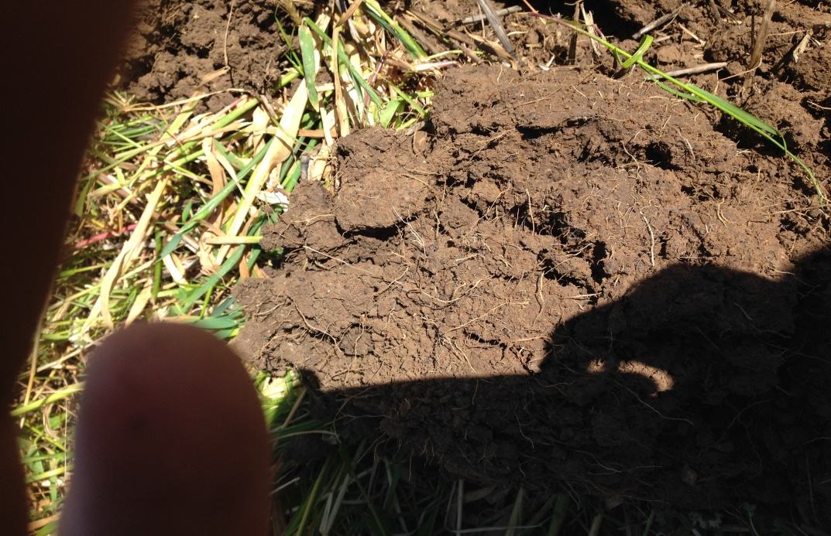
Improving our soil health through a systems approach...

Slide 10
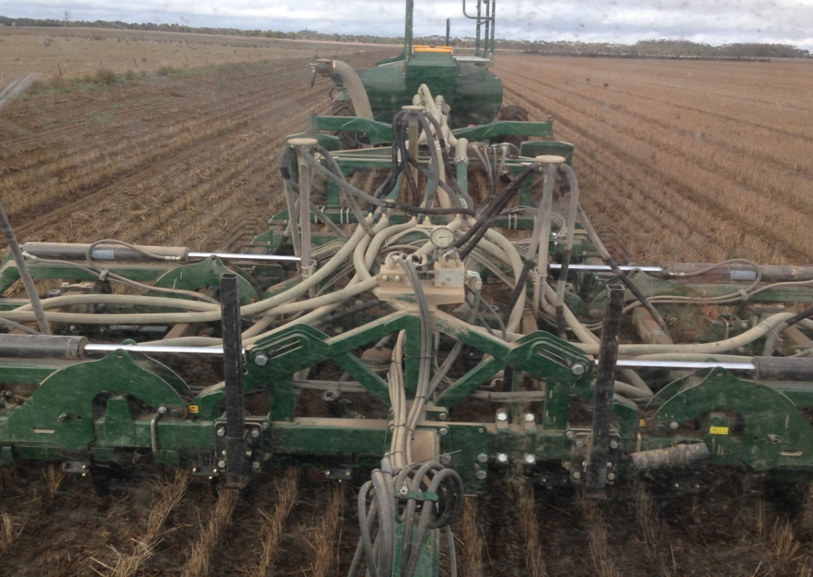
Five key principles we’re trying to adopt to improve our soil health…
1. The least amount of mechanical disturbance to the soil, as possible.
Notes:
Overarchingly, we are trying to improve our soil health through a systems approach and are trying to follow these five key principles – adopted by farmers in the US such as Gabe Brown and Rick Bieber.
Drill seeder – zero till

Slide 11
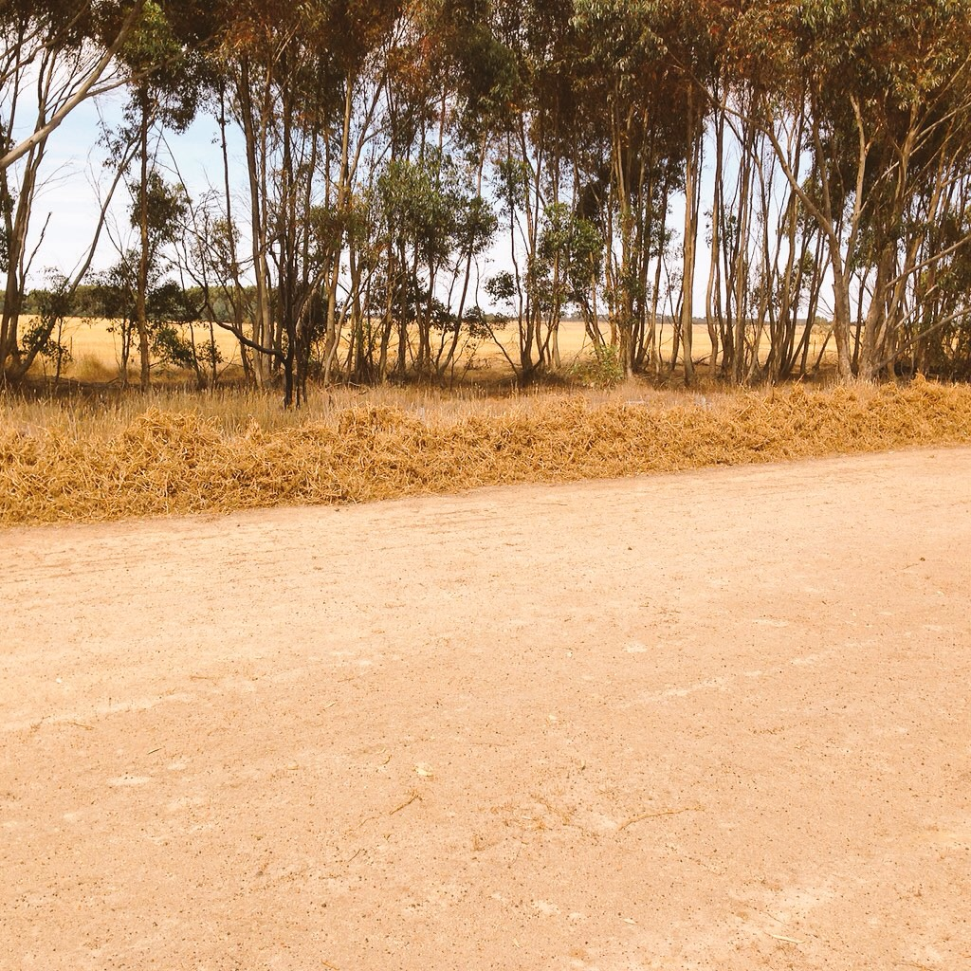
2. Covering the soil, all year round.
Notes:
This is what happens when you don’t have an ancor (root in the ground) peas we green manured after previously cutting for hay. All the residue blew up to the fence and exposed the soil.

Slide 12
3. Diversity (multi species mixes).
Notes:
Multi mix covers – trial and error but now feel we’re getting in right!

Slide 13
4. Keep a living root in the ground year round.
Pictured: Rick Bieber
Notes:
This picture is of Rick Bieber who Evan visited in the states a couple of years ago. Rick had seeded directly after the header. We are hoping to do this this year for the first time – sowing warm season mix e.g millet, sunflowers etc.

Slide 14
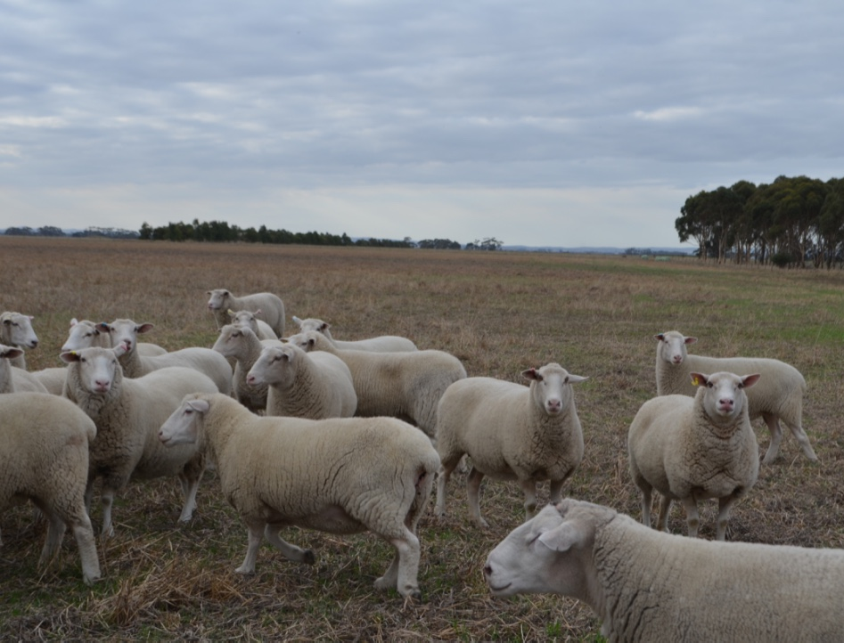
5. Grazing livestock (I really like this last one!)

Slide 15
What we’re trying to achieve on the sheep side of things…

Slide 16
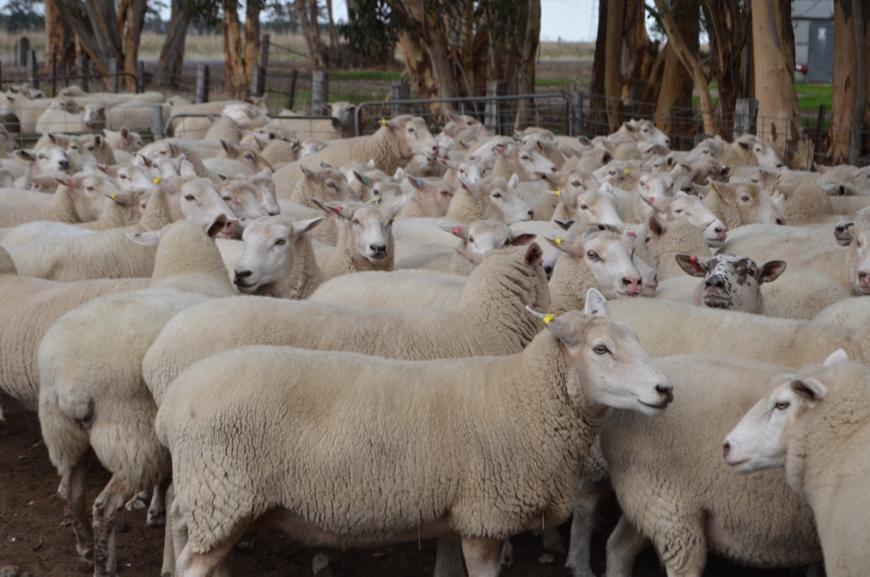
Tough, drought resistant, worm resistant ewes.
White Suffolk Composite
(Warrayure Prime Lamb Sires)
Notes:
Work with my brother on the genetics to produce a tough, drought resistant, worm resistant ewe. Choosing for positive eye muscle depth and positive fat for lamb survival. We use to have troubles with hypoglycaemia and hypocalcimia with the Coopworth lines, but these are much tougher – big roomy ewes can fit triplets at full term and also something in their stomach.

Slide 17
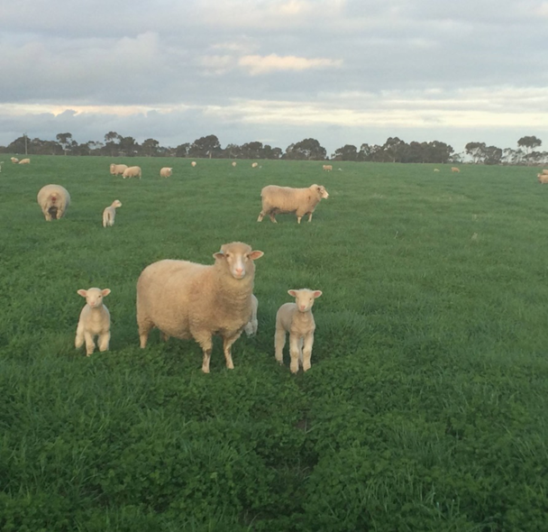
High Fertility
Notes:
Photo of last year maiden raising triplets on pasture legume cover. High fertility, I believe, a combination of nutrition a key times (rising plan of nutrition – ewe never been checked) and genetics

Slide 18
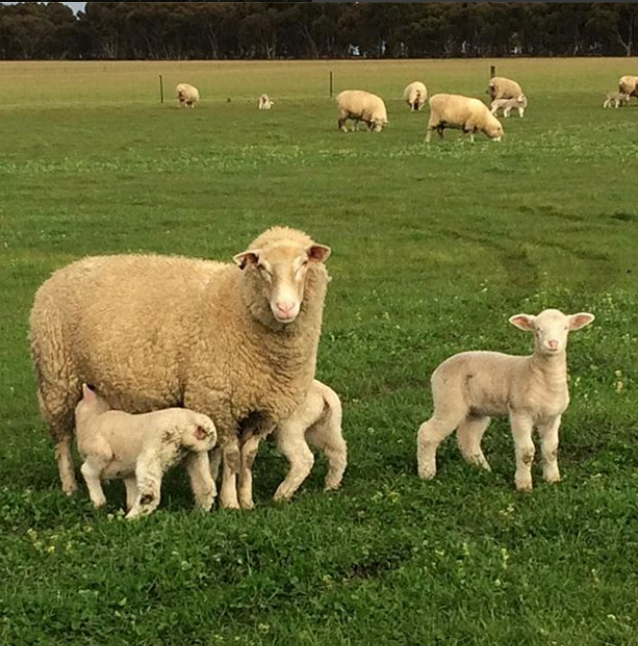
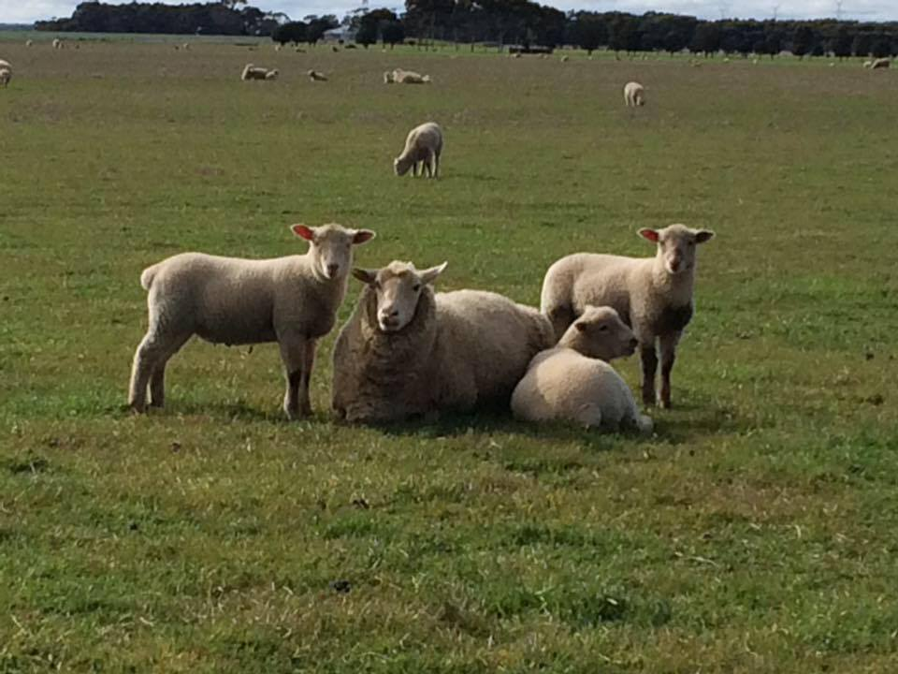
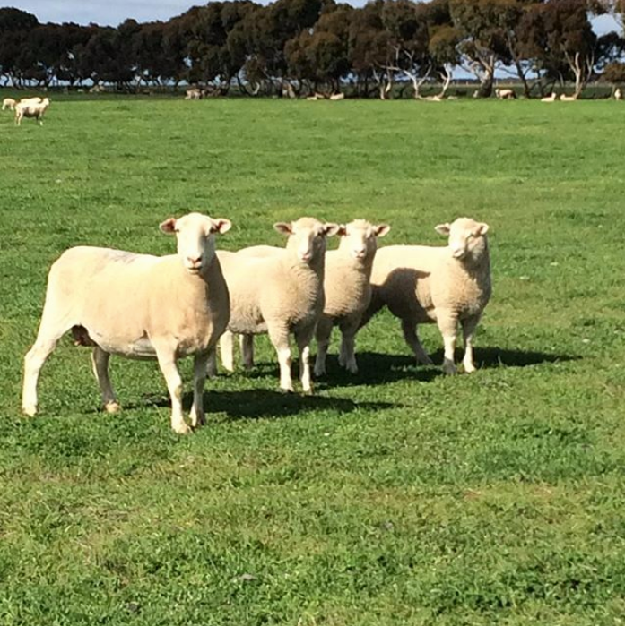
Maternal Instinct – the ability to raise multiples.

Slide 19
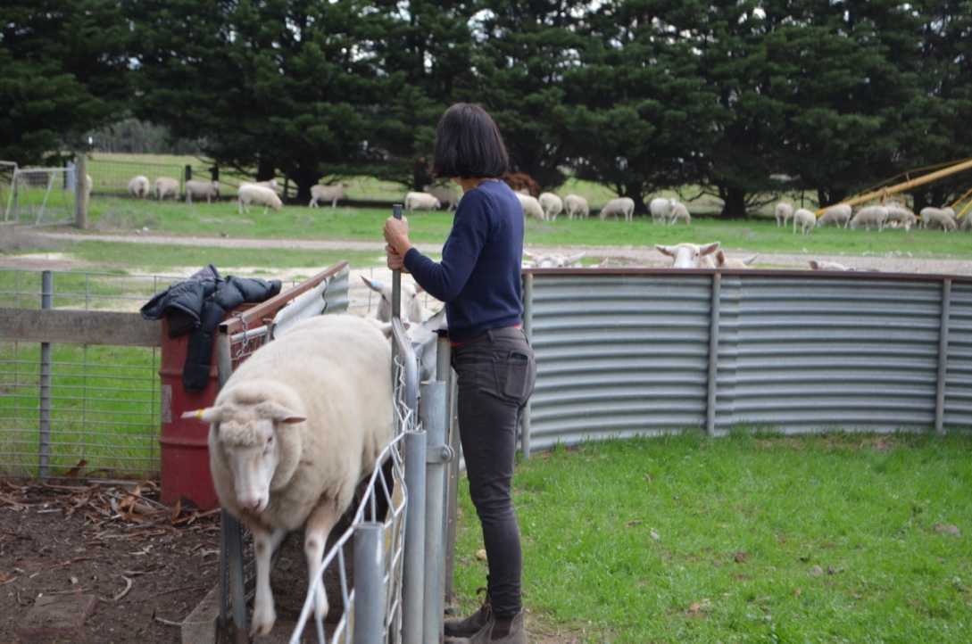
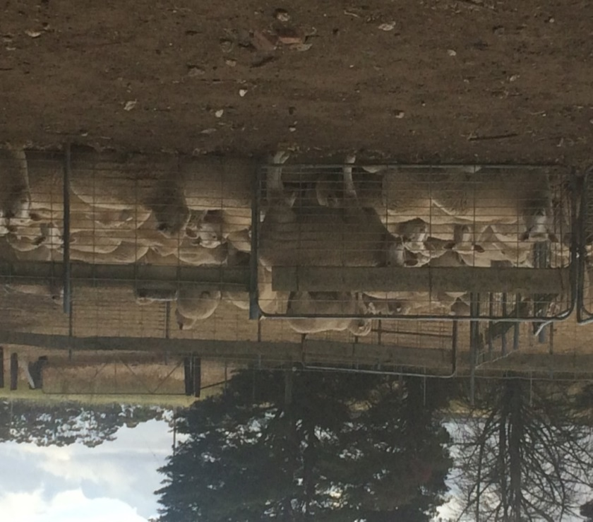
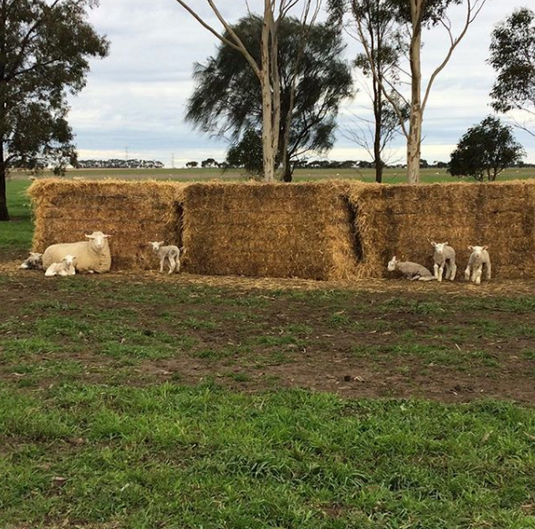
My low-stress sheep management approach
Notes:
How it evolved….Many experiences over the years and working autonomously as a women. Finding fewer losses, greater profit.

Slide 20
Some of my low-stress management principles….
Aim to minimise any physiological and psychological stress throughout the lifespan (being intuitive).
No mulesing (bred wool of breech area).
Later weaning/staggered weaning (around 16 weeks – but does depend on season, condition score of ewes).
No drastic change of feed (imprint feeding before weaning and/or change of feed).
Never coincide two stressful events together (e.g shearing and weaning).
Multigenerational mobs (e.g. older ewes in with maidens).
Notes:
These principles have formulated from what I have observed and learnt over the years – so often anecdotal/intui tive not necessarily scientific.
e.g. no physiological stress – always have the feed in front of them, eliminate any worm burden, and keep them free from any disease (hypo . Feet - foot baths – zinc sulphate. Reduce psychological stress – by keeping the animal healthy – no long yarding, shelter, shade and good water at all times – no long yardings (periods without feed or water). Always have fresh water – not brackish bore
Breeding wool of breech means no mulesing and we are now getting away without a pre lambing crutch , which reduces the stress on the ewe pre lambing.
Later weaning – this helps by the ewe teaching the lamb how to graze/forage in stubbles such as bean stubbles and of course keeping the lamb stress free in times of change of feed, paddock – shearing etc. ( I never shear and wean at the same time)
No drastic change of feed will imprint feed and for example if I’m putting lambs on bean stubbles ,I will imprint feed with beans – no drastic change of feed. There is a method behind the madness, science does tell us that a lambs microbes (important for digestion and utilisation) can take up to two weeks to adapt to a change of feed, particularly, from dry feed to say a legume cover or cover. In these circumstances I will provide a drift off area.
Explain past experiences of weaning onto lucerne – red gut. Green feed e.g. rape – skirt around the edges for the first two weeks – losing or at least not gaining weight.

Slide 21
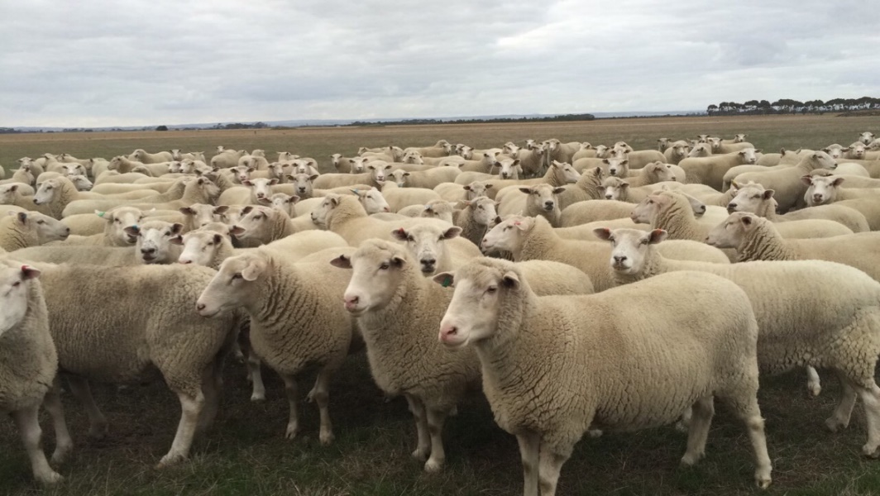
Low stress sheep handling rules…
No fear or force = No dogs in yards.
Reduce flight zone (reduce adrenaline).
Calm body language important.
Minimise time spent in the yards.

Slide 22
Low stress management improves trajectory of growth…
Growth
Birth
Sucker draft/weaning
Notes:
I believe low stress sheep management improves the trajectory of growth,. The lamb is not checked at any stage. We are aiming for a 450gram gain per day from birth to sucker draft/weaning – early weaning/change of feed can check the lamb, so in fact it may lose weight or not gain for a week or so.

Slide 23
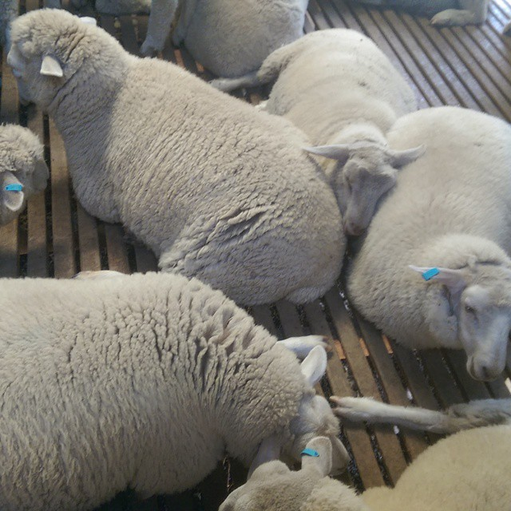
Happy Sheep
Notes:
Proof in the pudding. Lambs waiting to be shorn in pen before catching pen – feeling very relaxed!

Slide 24
Healthy soils = Healthy feed + Low Stress Management = Healthy, Heavy, Happy Lambs
Notes:
Legume cover1 Rocket fuel!! 1st sucker draft – lambs 20 weeks av weighed 65kg live weight, kill weight 32kg av.

Slide 25
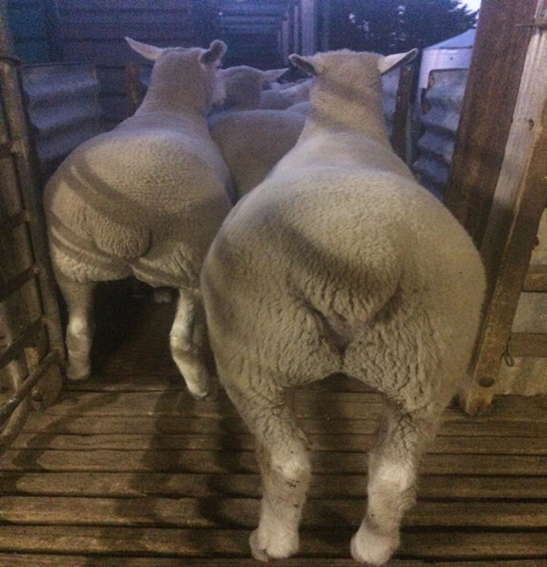
= (meat per hectare) = $$

Slide 27
What we’re trying to achieve on the cropping side of things…

Slide 28
The four majors…
Reducing input costs by minimum disturbance and sound rotation.
Reducing weed seed numbers to a controllable level, leading to a reduction in chemical use.
The use of legumes has allowed us to unwind our dependence on Urea.
Using a diversity of covers has improved soil health (especially on heavy clay soils).
Notes:
Bank managers comments on inputs? Well below industry standards.

Slide 29
Using plants to help improve our hard setting heavy clay soils
Notes:
Improving Porocity

Slide 30
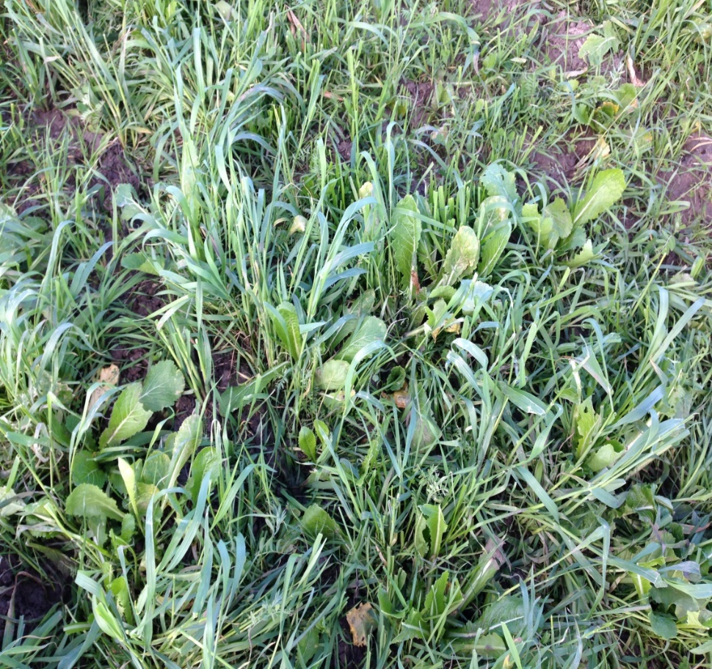
Mixed species cover crop journey
Notes:
!st cover was a learning curve.
Rye corn, clovers, vetch, rye grass. The rye corn smothered everything and because we didn’t have the mix quite right, they were all cool season species.. Sheep didn’t like it and skirted around the edges.

Slide 31
A mixture of cool and summer varieties increases soil biology.
Notes:
This years cover we now have the triplets lambing on

Slide 32
The synergy between the two…

Slide 33
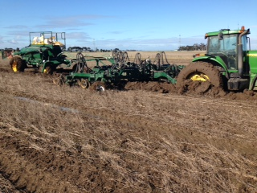
Sheep helping out the cropping side of things…
Livestock are an essential component of soil health; pooing and weeing and trampling this into the soil = improved soil biology.
Grazing of stock helps break down residue (easier to sow into, particularly this season and a disc drill machine).

Slide 34
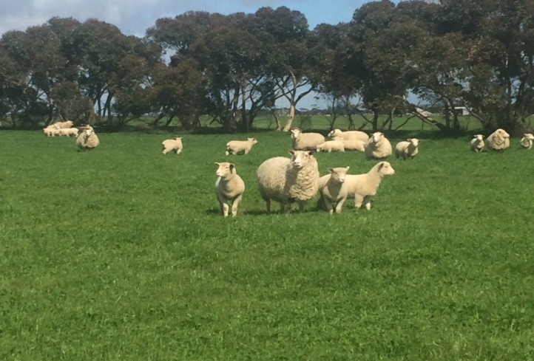
Break crops of legume covers/mixed specie covers can reduce future cropping costs (and substantially increase profits of the sheep enterprise)
Legume covers are sown into our problem ryegrass paddocks – instead of chemical use, sheep are used as a tool to graze seed numbers down.
Also spray top and graze – to sterilise seed
(We feel), hay takes away from the system – reduces amount of residue and exposes the soil surface – nutrient removal.
So for us, grazing is the key!

Slide 35
How this system benefits the sheep…
Increased fertility (legume covers and faba bean stubbles).
Allows for greater selective grazing (diversity in diet).
Reduces/eliminates any supplementary feeding.
Improved animal health outcomes – sheep like diversity.
Minimises any worm burden (haven’t drenched older mobs for over 2 years).
Notes:
Increased fertility , especially from faba bean stubbles
Haven’t drenched for over two years, FEC done regularly. This is (I believe due to rotation of cover, stubbles and pasture legumes).

Slide 36
The challenges:

Slide 37
2017:another challenging year for us…

Slide 38
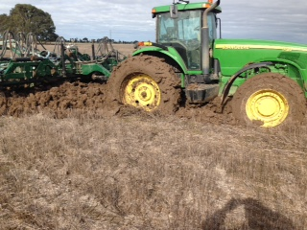

Slide 39
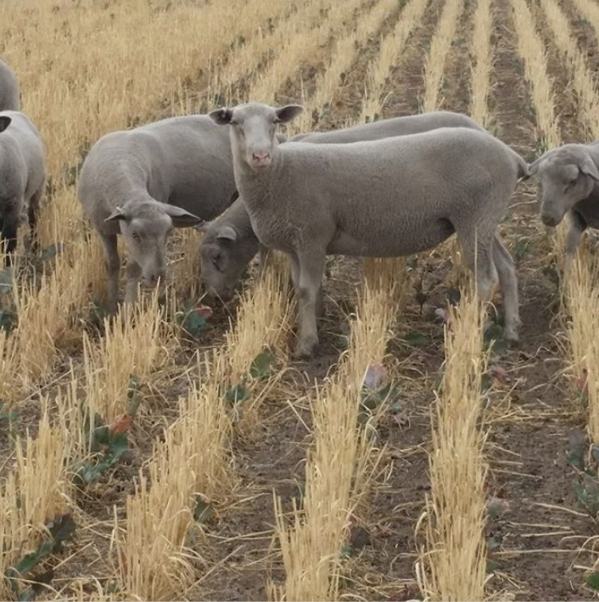
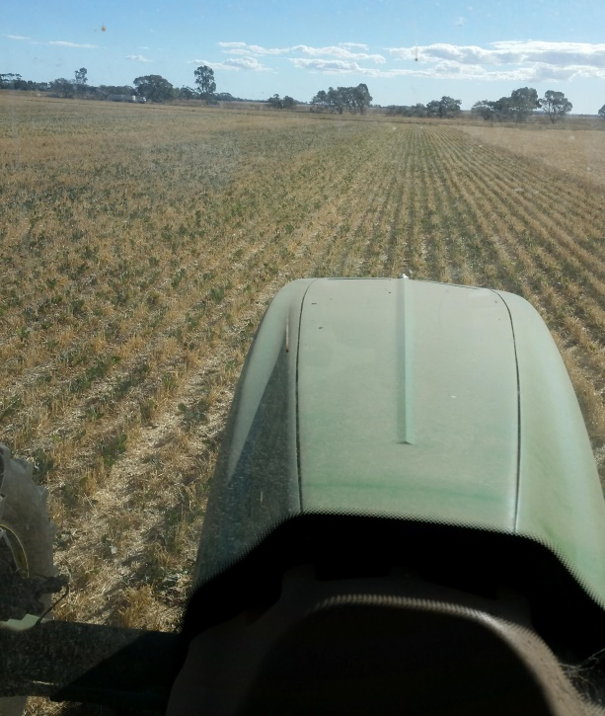
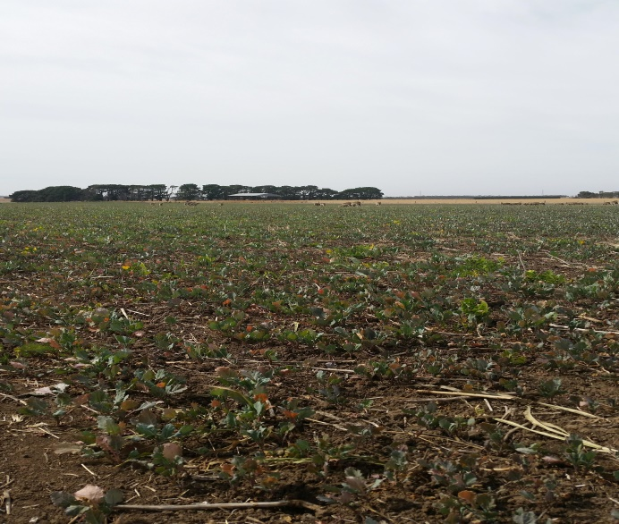
But there’s always a silver lining.....

Slide 40
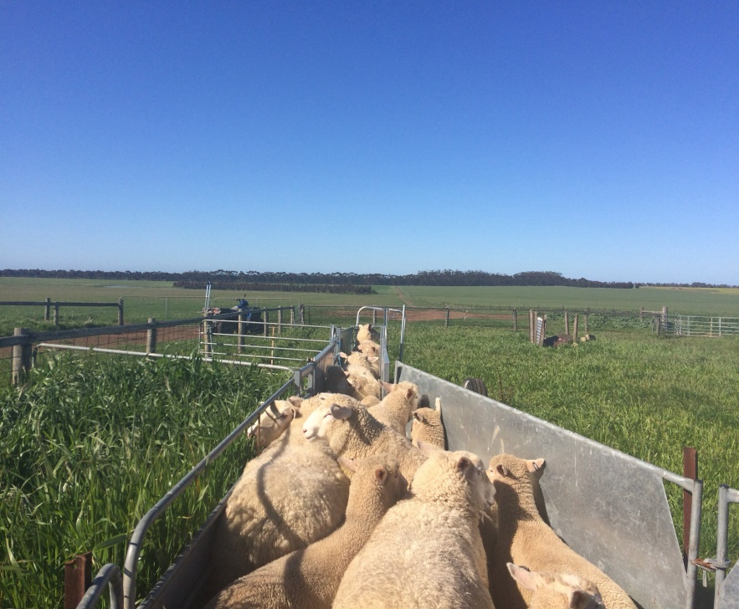
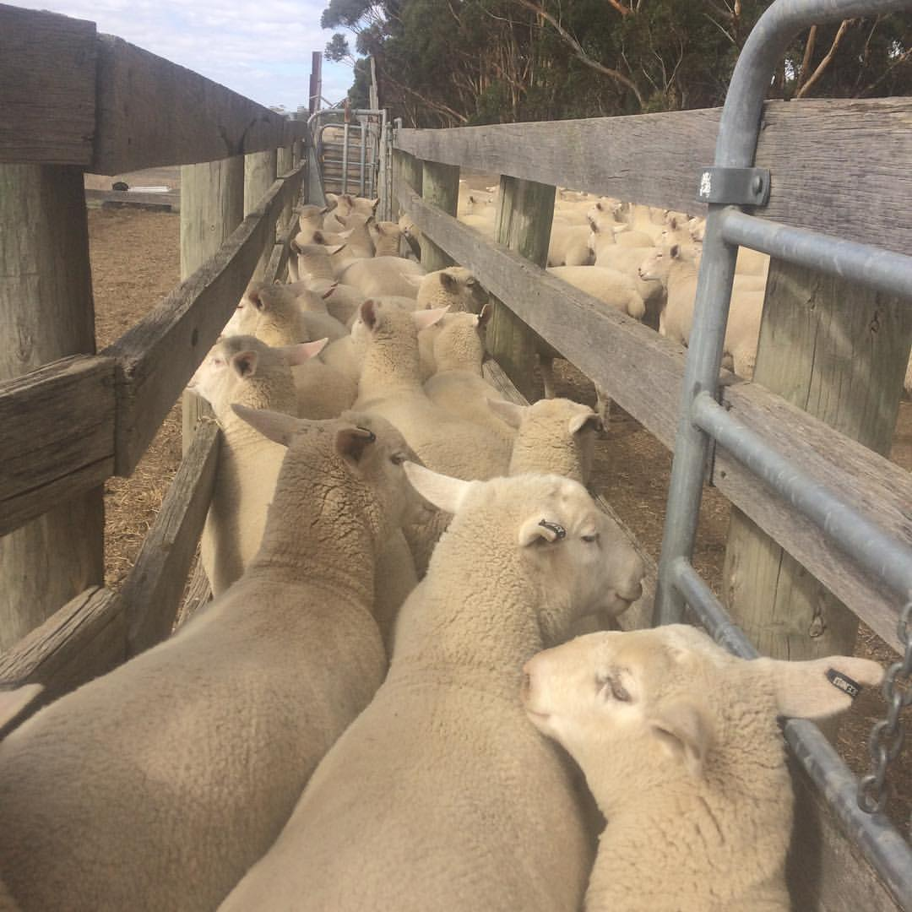
Management issues of different blocks…timing and planning
Notes:
Timing and planning.

Slide 41
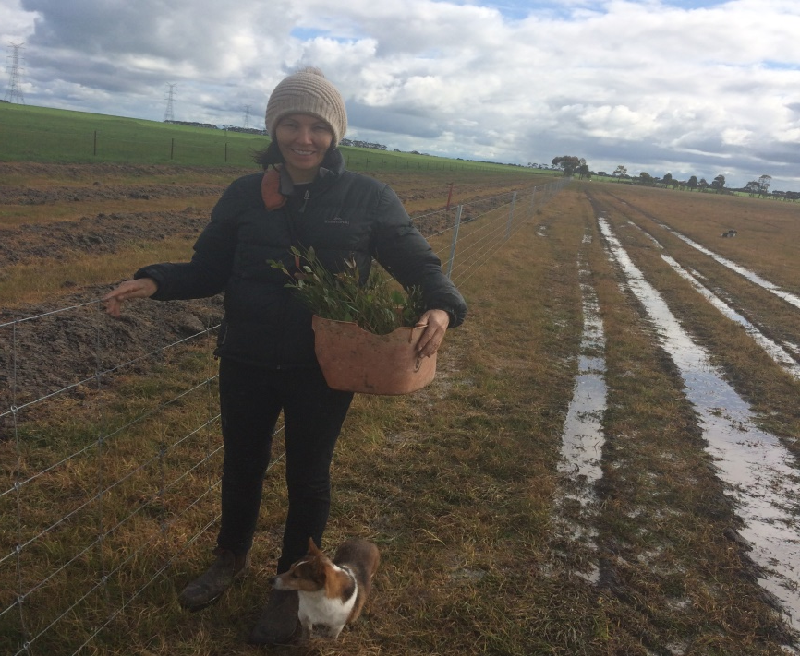
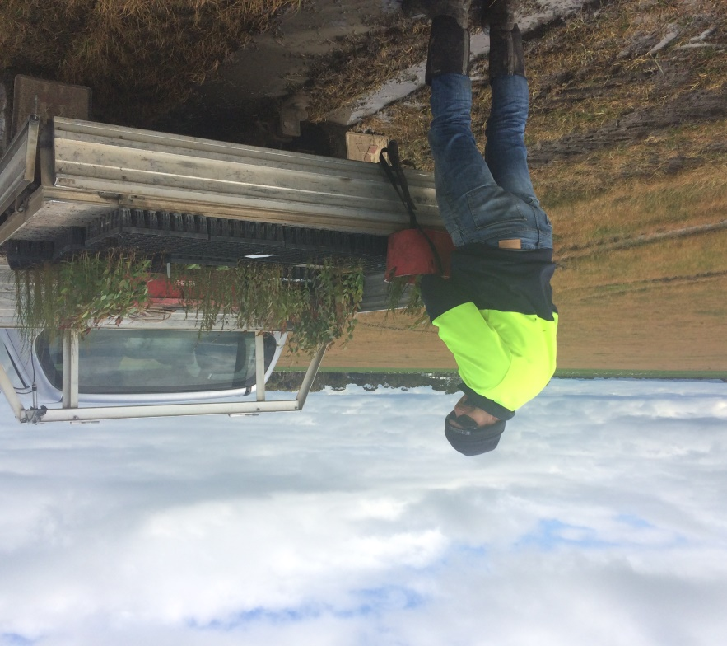
What we’re trying to achieve in the future…
Continue to improve our soil health (five key principles)
Increased tree planting to attract pollinators and provide shelter for sheep

Slide 42
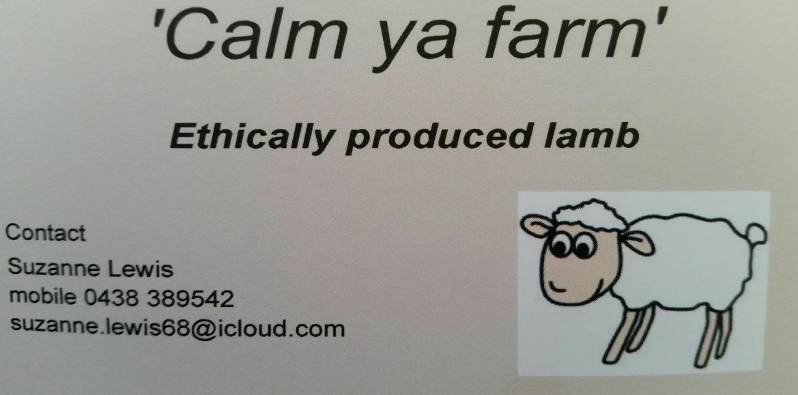
Diversity of grazing – introducing cattle More effective grazing of covers (Virtual fencing technology) Markets for my ‘Calm ya farm’ ethically produced lamb

Slide 43
Lastly, just a few words about farmer wellness…
#standupforfarmerwellness
Notes:
Lastly, I’m going to combine my farmers and health sciences hat and talk about farmer wellness

Slide 44
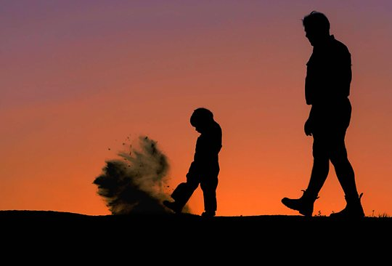
Ongoing research suggests Australian farmers have poorer health outcomes than the rural average (Brumby et al. 2012).
Overweight/obesity
Type 2 diabetes
Cardiovascular disease
Poor mental health outcomes

Slide 45
Health differentials? Lower levels of physical activity? Too much time spent ‘sitting’? .

Slide 46
Mechanisation of farming practises = lowers levels of PA
For example…
Broad acre cropping enterprises;
GPS/auto steer machinery.
High production periods (sowing and harvest) may mean 12-15 hours spent sedentary (‘sitting’ in tractor).

Slide 47
There is now a strong evidence base that tells us…
‘Even small amounts of physical activity (and ‘sitting’ less) can improve our physical, and most importantly mental health’.

Slide 48
What can be done?

Slide 49
Importantly…
Support one another to make positive change.
No bagging out your mate!

Slide 50
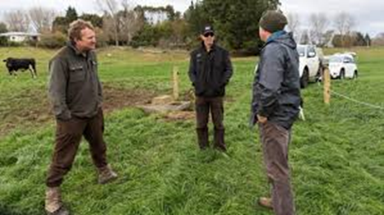
Just a quick word about mental health from a farmers perspective:

Slide 51
Farming is a journey not a competition
Social media BEWARE!

Slide 52
Keep talking and sharing the good stories along with the bad.

Slide 53
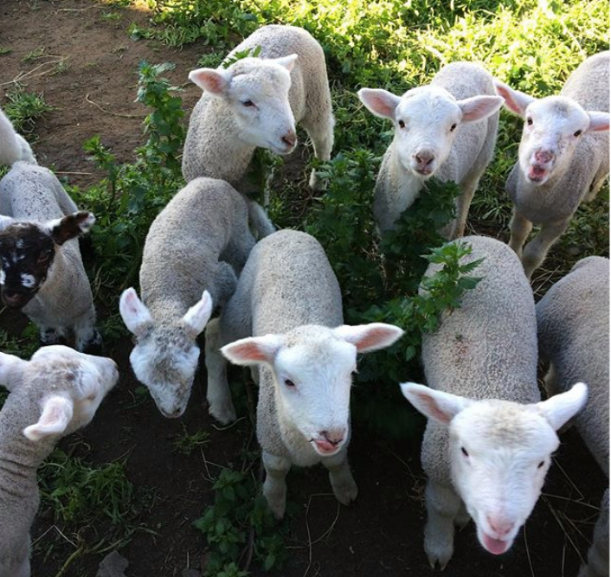
Thank you

