Slide 1
2018 FARMING FOR SUSTAINABLE SOILS CONFERENCE
PHIL DYSON
PROJECT MANAGER

Slide 2
A community–based approach to improving soil health
Farmers are doing it for themselves – apologies to the Eurythmics……

Slide 3
Communities taking responsibility for soil health

Slide 4
Appreciating the inherent properties of the land
Notes:
Workshops: Doris Blaesing, San Jolley, Jim Shovelton, Neil Hives, Nick Shady, Andrew Bissett/ Dale Boyd, Russell Nichol (spreader cal), Simon Falkiner, Kilter bus trip, GRDC updates
Trials: Soil Ameliorants (Pooley, Byron), Tillage Radish, Subsoil manuring, Pulse trial, Summer crops, Summer cover crop
Technology: Soil moisture probes, weather stations, Drones, NDVI imaging

Slide 5
Assessing the condition of soils

Slide 6
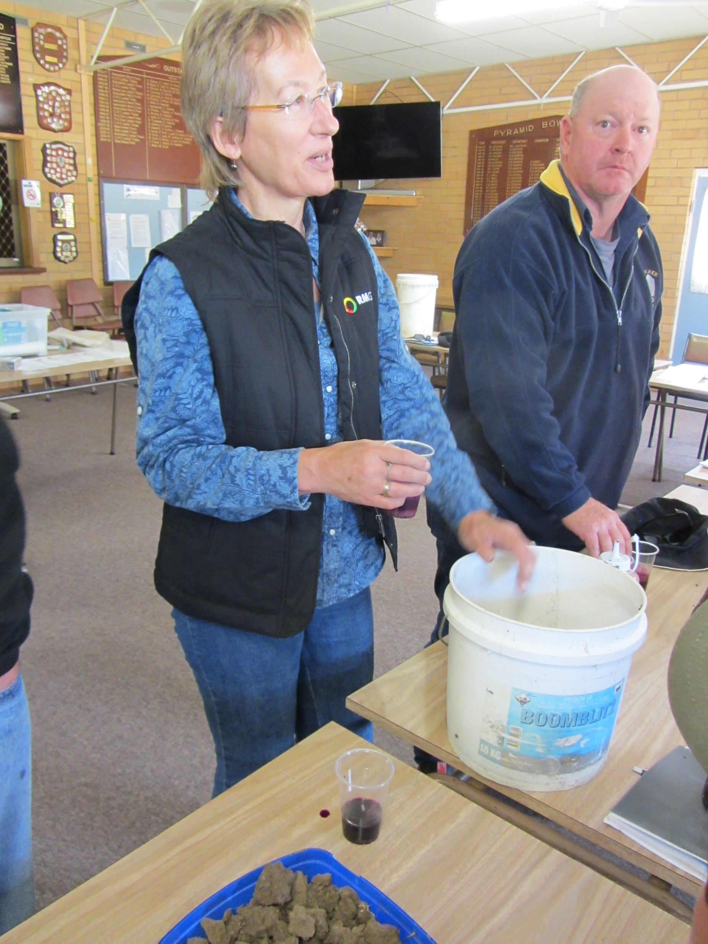
Building community knowledge through access to experts

Slide 7
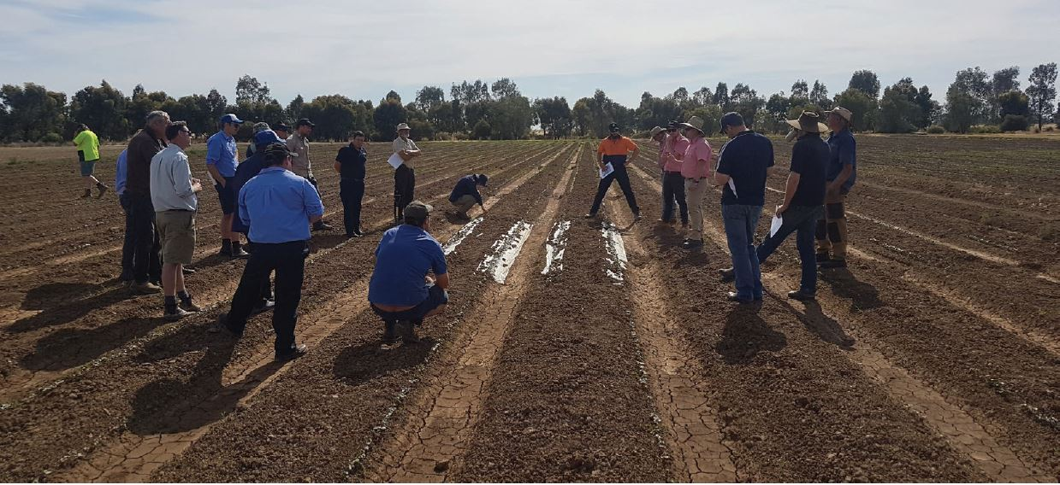
Conducting farm-based field trials – gaining experience and confidence

Slide 8
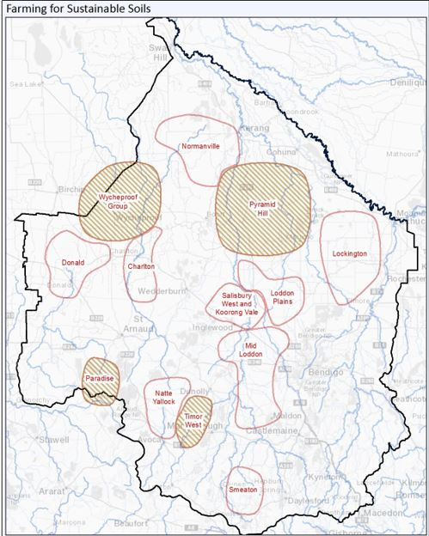
A network of farming communities intent on improving the health and productivity of their soils

