Slide 1
2018 FARMING FOR SUSTAINABLE SOILS CONFERENCE
Merron Ipsen
Timor West FSS

Slide 2
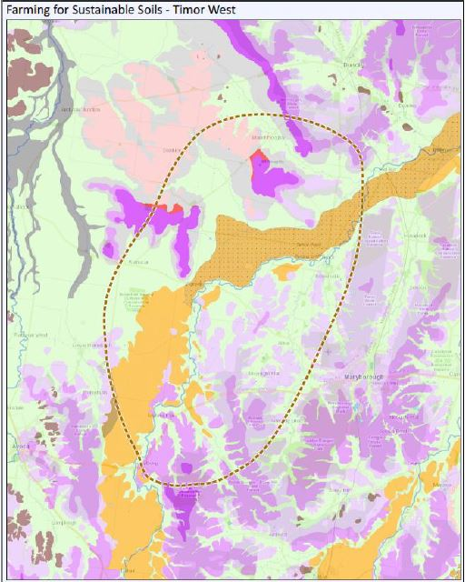
TIMOR WEST FSS GROUP
Dunolly
Who are we?
Group formed from local landcare group
Bet Bet to Bung Bong
Rathscar to Maryborough
What are our main enterprises?
Broadacre cereal cropping
Hay
Dryland grazing – mostly sheep/lambs
Maryborough
Avoca

Slide 3
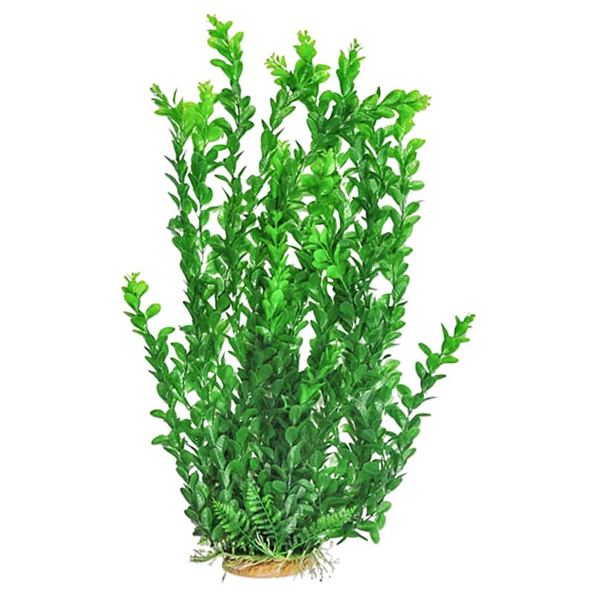
LOCAL ISSUES
Topsoil (fine sandy loam or loam)
Variability, structure and high pH at depth
Poor soil structure – generally sodic soils and shallow rooting zone
Hostile A2 or B horizons –some with limestone concretions, generally increasing pH with depth.
*Issues confirmed through physical and chemical (laboratory) assessments
Our interests are in improving the health of our soils – need to increase organic matter.
Often Sodic subsoils >6% ESP Shallow rooting zone to 60cm due to concretion in A2 or high pH
1.0 metre
Clay/loam subsoil
Highly weathered granite

Slide 4
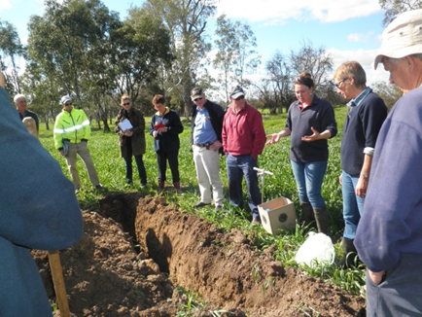
Our Journey
Understanding our issues:
Baseline Assessment in lab and field (soil cores)
Soil pits
Paddock by paddock assessment
Improving our understanding:
Professionals from laboratory, department,
peers and private sector
Soil workshops and field days
Demonstrations of our learnings
Testing the options that might work for us

Slide 5
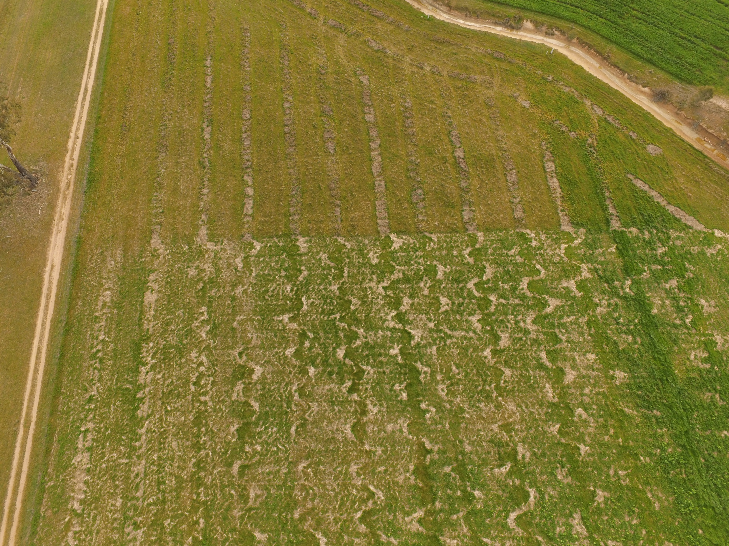
LEARNINGS
Synergy of existing programs and networks
Community led approach
Social impact
Addressing the issues

Slide 6
THANK YOU

