Slide 1
2018 FARMING FOR SUSTAINABLE SOILS CONFERENCE
CRAIG COSSAR
WYCHEPROOF and GLENLOTH-EAST FSS GROUP

Slide 2
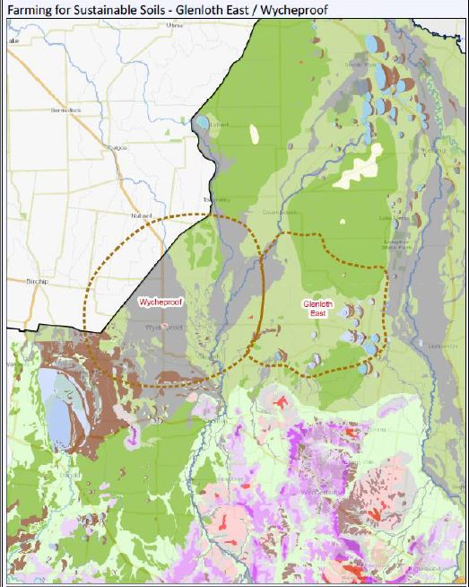
Wycheproof,Glenloth-East Fss Group
Who are we?
Farming community from the northern (Riverine)
plains
Dumosa to the north to Teddywaddy in the South
Tchum lake in the west though to the West of Boort
What are our main enterprises?
Dryland cereal cropping
Dryland grazing mostly sheep and lambs
A little irrigation and some intensive farming piggery

Slide 3
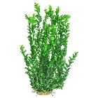
LOCAL ISSUES
Topsoil ( sandy loams, sandy-clay loams )
Subsoil Constraints
Poor soil structure – sodic soils
Soil profiles vary significantly, from duplex profiles to gradational clays
Hostile subsoils – limestone concretions
*Issues confirmed through physical and chemical (laboratory) assessments
Our interests are in improving the health of our soils – farming systems that improve our soil structure
Sodic clay subsoil - dispersive with poor structure
Clay subsoil
1.0 metre
Limestone concretions and boron problems(high pH)

Slide 4
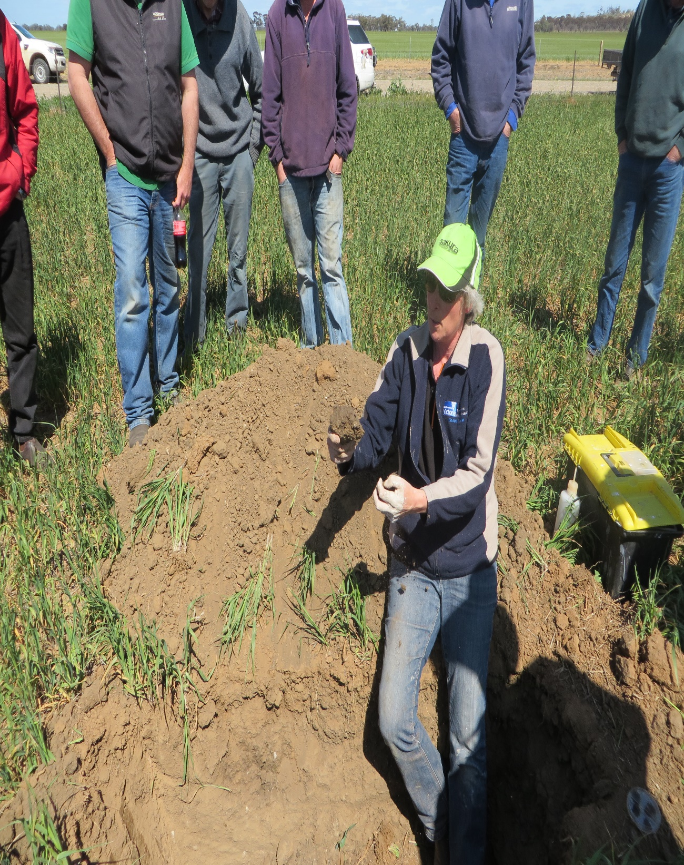
LOCAL APPROACH
Understanding our issues:
Assessment – How healthy are our soils?
Laboratory assessments, 66 soil pits
Physical examination
Improving our understanding:
Workshops and field days
Trials and demonstration
Testing the options that might work for us

Slide 5
Sixty-six soil pits around Wycheproof

Slide 6
Soil Scientist Christian Bannan with soil group members

Slide 7
Hostile lime at 500mm depth

Slide 8
Grey self mulching clays

Slide 9
Deep ripping with Yeomans plough with crumb roller 2014

Slide 10
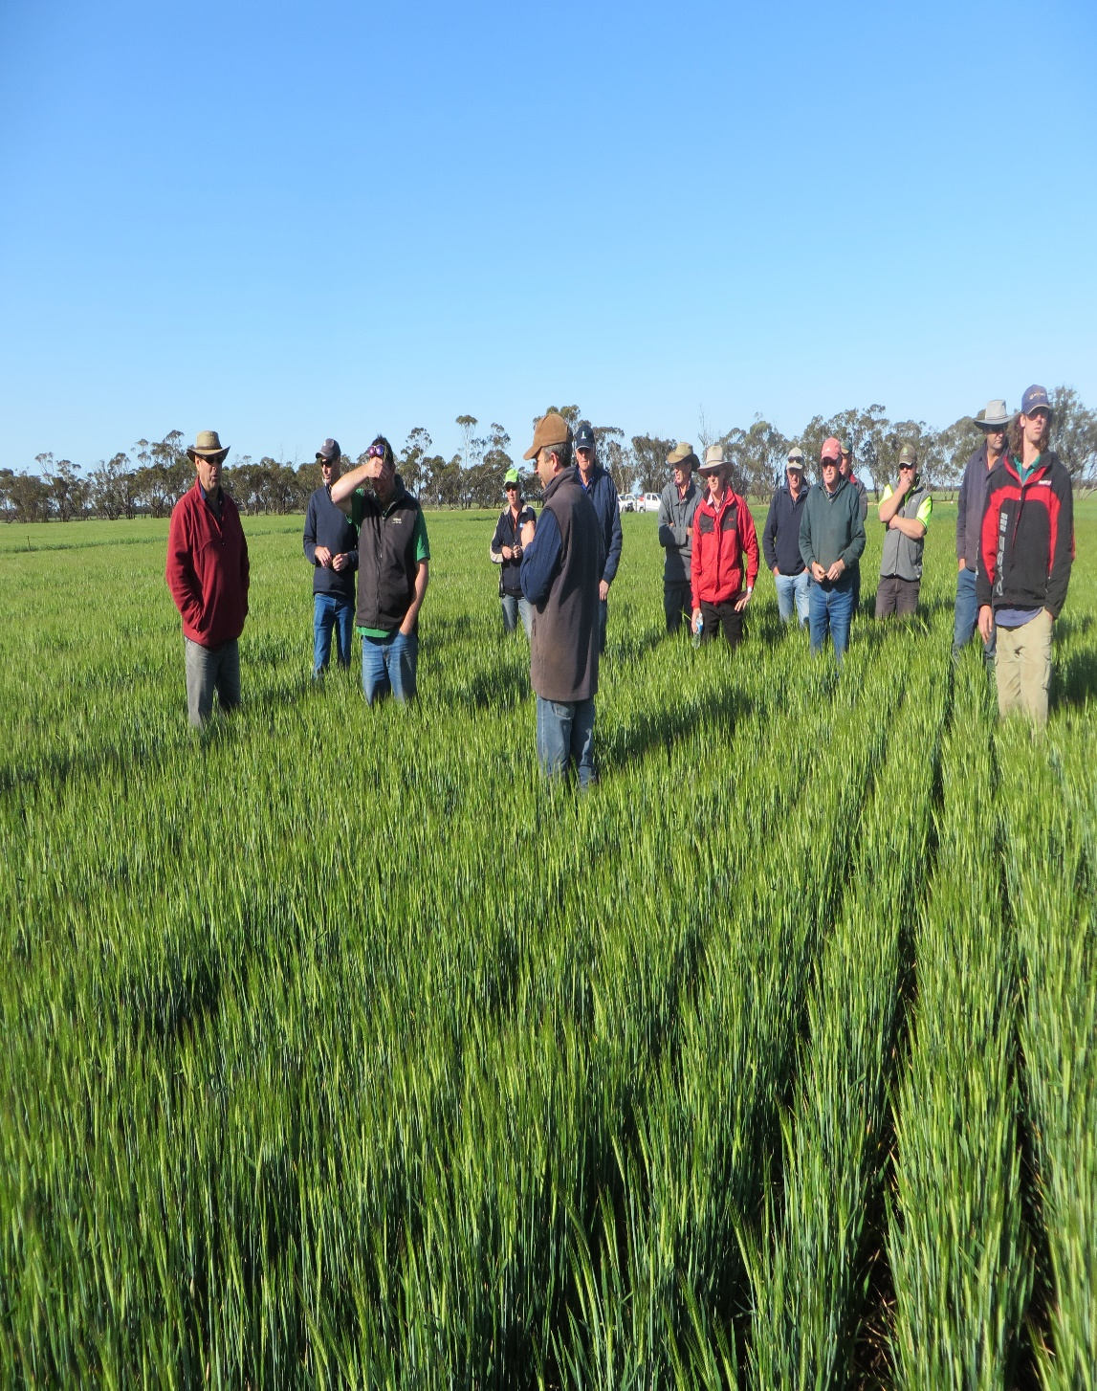
LEARNINGS
About community-based land management and land protection?
About people-based approaches?
About resolving the issues?

Slide 11
Late August 2015 Drought

Slide 12
Tillage Radish Trial 2016

Slide 13
Tillage Radish 2016/Grazing

Slide 14
Liquid Fertiliser trial 2017

Slide 15
Disc air-seeder with liquid fertiliser unit

Slide 16
Controlled traffic

Slide 17
San Jolly Livestock Nutrition Workshop

Slide 18
Weather stations and moisture probes

Slide 19
Local communities coming together to improve knowledge and social wellbeing

Slide 20
THANK YOU

