Slide 1
2018 FARMING FOR SUSTAINABLE SOILS CONFERENCE
ADAM TWIGG
PYRAMID HILL FSS GROUP

Slide 2
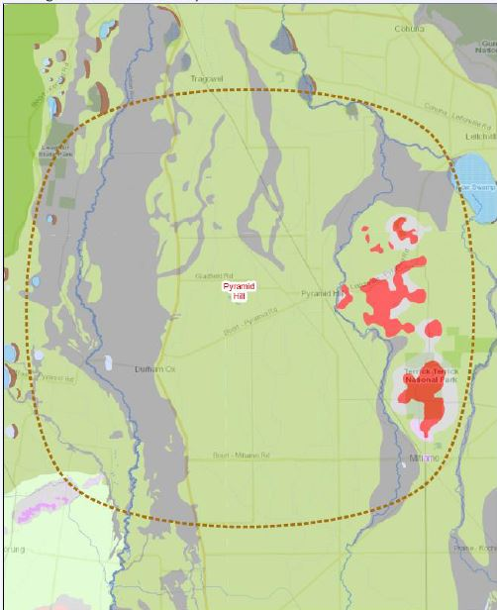
PYRAMID HILL FSS GROUP
Appin south
Who are we?
Farming community from the northern (Riverine)
plains
Appin South in the north through to Mitiamo
Durham Ox in the west though to the Terrick Ranges
What are our main enterprises?
Irrigation – dairying, horticulture, etc.
Dryland cereal cropping
Dryland grazing – mostly sheep/lambs
Pyramid Hill
Terrick Ranges
Durham Ox
Mitiamo

Slide 3
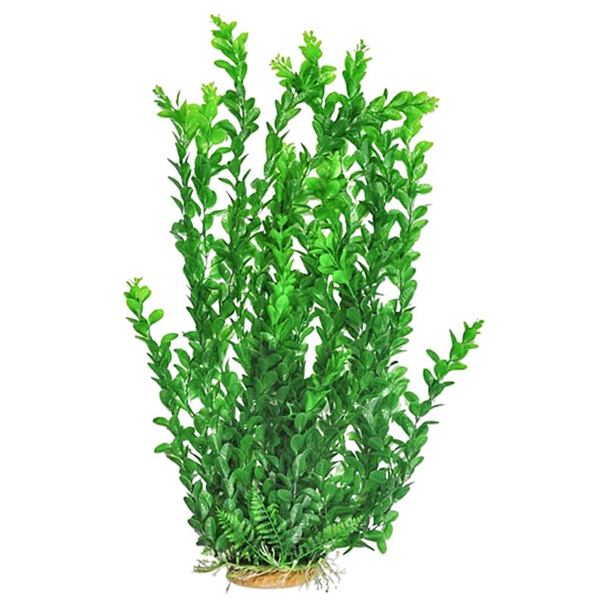
LOCAL ISSUES
Topsoil (fine sandy loam
Subsoil Constraints
Poor soil structure – sodic soils
Residual subsoil salinity issues
Hostile subsoils – limestone concretions, gypsum layers and salinity
Issues confirmed through physical and chemical (laboratory) assessments
Our interests are in improving the health of our soils – farming systems that improve our soil structure
Sodic clay subsoil - dispersive with poor structure
Clay subsoil
1.0 metre
Saline clay with limestone concretions (high pH)

Slide 4
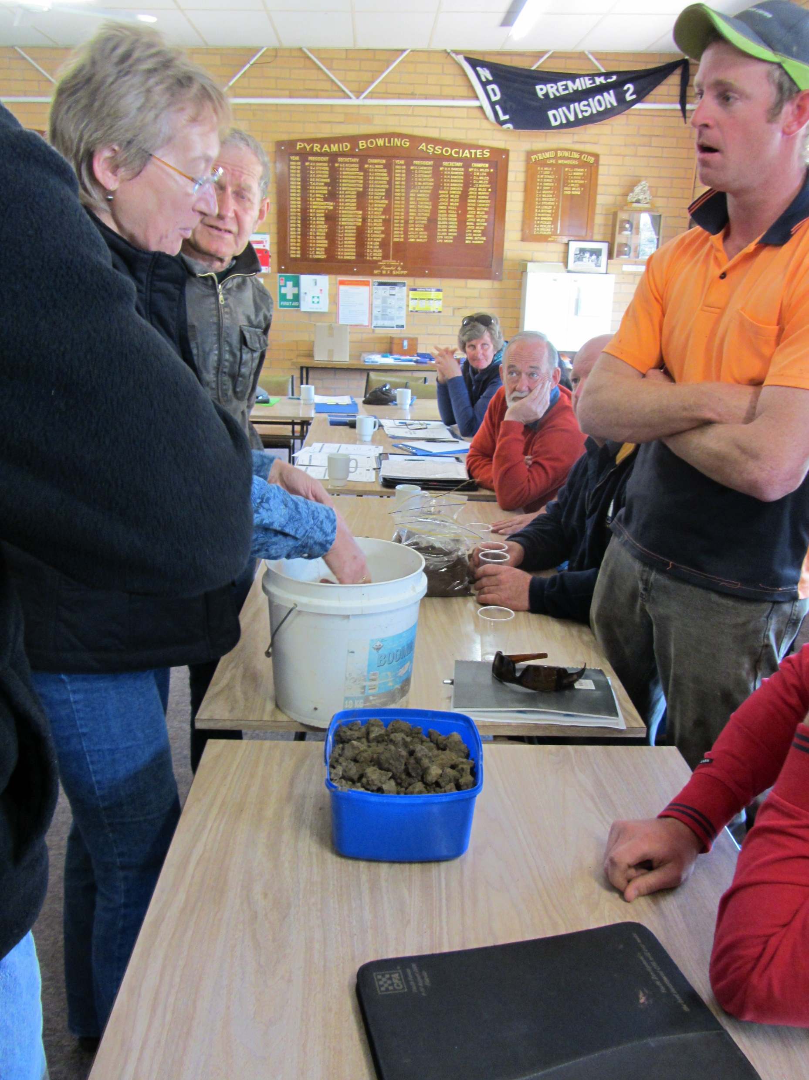
LOCAL APPROACH
Understanding our issues:
Assessment – How healthy are our soils?
Laboratory assessments
Physical examination
Improving our understanding:
Workshops and field days
Trials and demonstration
Testing the options that might work for us
New Technology
Notes:
Workshops: Doris Blaesing, San Jolley, Jim Shovelton, Neil Hives, Nick Shady, Andrew Bissett/ Dale Boyd, Russell Nichol (spreader cal), Simon Falkiner, Kilter bus trip, GRDC updates
Trials: Soil Ameliorants (Pooley, Byron), Tillage Radish, Subsoil manuring, Pulse trial, Summer crops, Summer cover crop
Technology: Soil moisture probes, weather stations, Drones, NDVI imaging

Slide 5
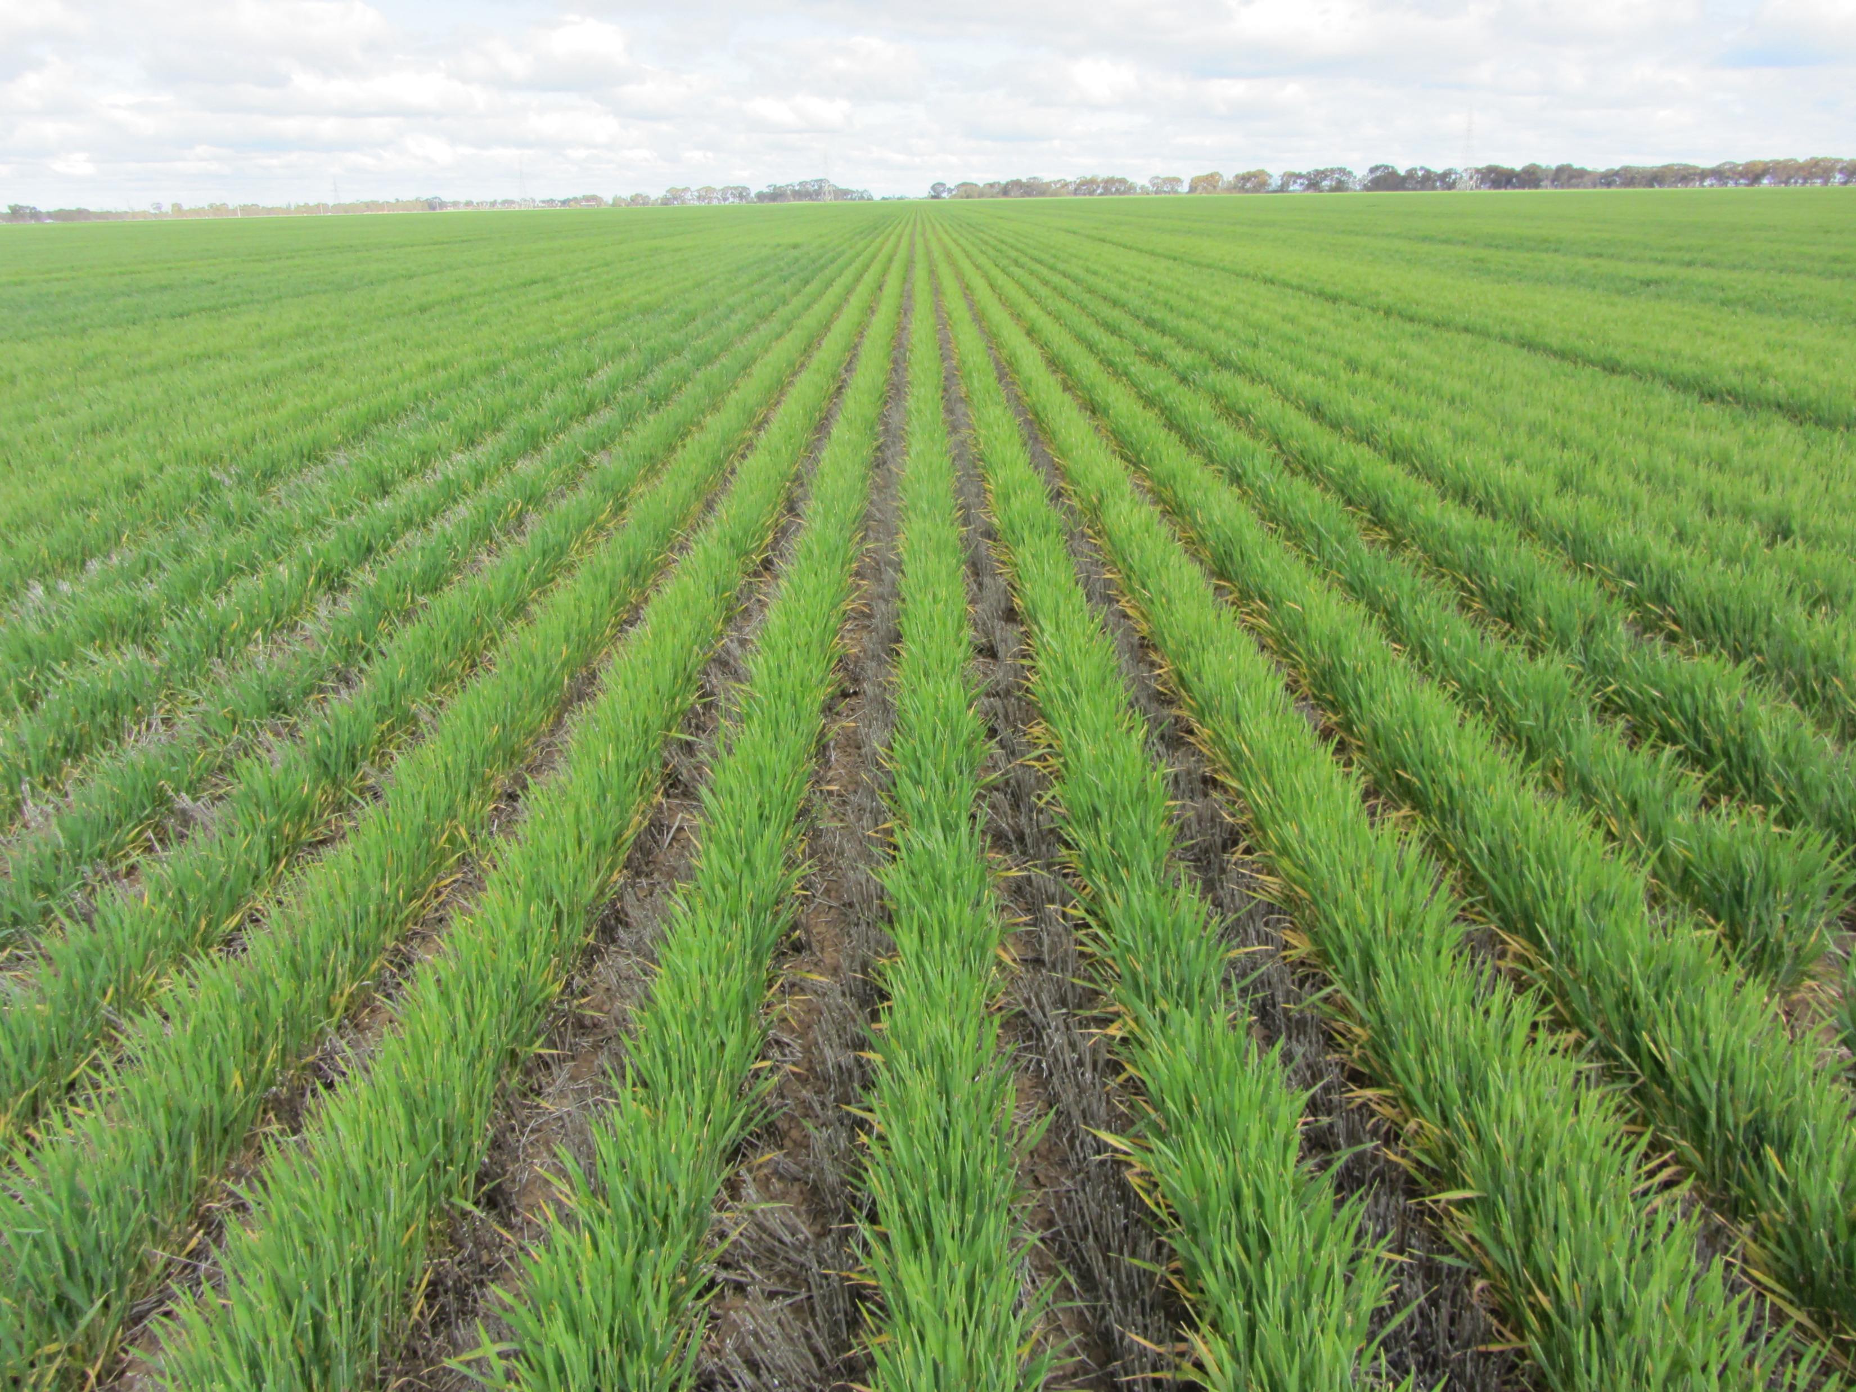
LEARNINGS
About community-based land management and land protection?
About people-based approaches?
About resolving the issues?

Slide 6
THANK YOU
How has your group valued the opportunity?
Local farming communities coming together in an effort to improve the condition of their soils?

